Slide 1
Coursera Capstone Project – The Battle of Neighborhoods Exploring venues for apartment in Manhattan
Author
Prashant Joshi
May 03, 2020

Slide 2
Contents
1 Introduction
1.1 Background
1.2 Problem
1.3 Interest
2 Data acquisition and cleaning
2.1 Data Sources
2.2 Data Cleaning
3 Methodology
3.1 Exploratory Data Analysis
3.2 Modelling
4 Results
5 Discussion
6 Conclusion

Slide 3
1 Introduction
1.1 Background
In this era of globalization, many people tend to relocate, either to a city within the same country, or to a completely different country. Going to another country is always a whole new experience for anyone. People might not know about the locality they are going to, and might not rely on the locals. Getting a proper is a tedious task. Due to this, the people, especially the students and working-class people suffer a lot in finding a better place to rent which is affordable and nearer to several amenities. These things eventually becomes turning factors in searching the places for rent.
1.2 Problem
To achieve this, considering Manhattan as the target location, I want to find the place to be rented, with following characteristics –
Apartment having at least 2 bedrooms
Monthly rent must not exceed UD$7000/month
Locality having similar ameneties and venues as compared to current location
Apartment having walking distance from a subway metro station

Slide 4
1.3 Interest
The person who may have desire to relocate to overseas cites like Manhattan might get benefit from this project. International students and the working people being shifted to Manhattan may find this project relevant and help themselves with finding a better apartment.

Slide 5
2 Data Acquisition and Cleaning
2.1 Data Requirements
Given below is the list of data required in this project:
Along with geodata, list of boroughs and neighborhoods of Manhattan
Dataset of Apartments for rent containing address and price respectively were gathered from websites of rantmanhattan.com, nestpick.com and realtor.com.
List of all neighborhoods of Manhattan to be used to cluster
2.2 Data Sources
Singapore data and map is to be created with the use of Nominatim, Foursquare and Folium mapping
Manhattan neighborhoods were obtained from Wikipedia and organized by Neighborhoods with geodata via Nominatim for mapping with Folium.
List of subway stations was obtained through Wikipedia, NY Transit Website and Google maps.
Folium map was the basis of mapping with various features to consolidate all data in one map where one can visualize all details needed to make a selection of apartment.

Slide 6
3 Methodology
Strategy
The strategy is based on mapping the described data in section 2.0 in order to facilitate the choice of at least two candidate places for rent. The information will be consolidated in one map where one can see the details of the apartment, the cluster of venues in the neighbourhood and the relative location from a subway station and from work place. A measurement tool icon will also be provided. The popups on the map items will display rent price, location and cluster of venues applicable.
Tools
Web-scraping of sites is used to consolidate data-frame information which was saved as csv files for convenience and to simplify the report. Geodata was obtained by coding a program to use Nominatim to get latitude and longitude of subway stations and also for each of (144 units) the apartments for rent.
Geopy_distance and Nominatim were used to establish relative distances. Seaborn graphic was used for plotting general statistics on rental data.
Maps with popups labels allow quick identification of location, price and feature, thus making the selection very easy.

Slide 7
4 Execution and Results

Slide 8
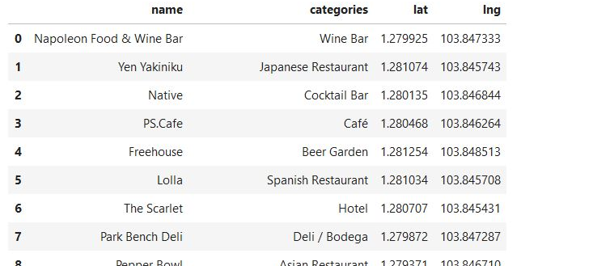
Venues around neighbourhood in Singapore

Slide 9
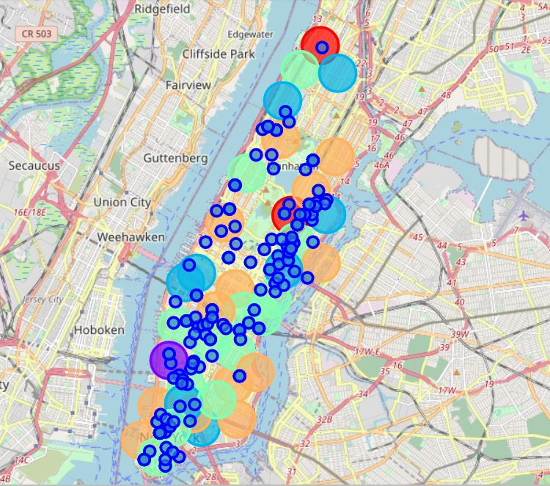
Map – Neighborhoods and cluster of venues in Manhattan

Slide 10
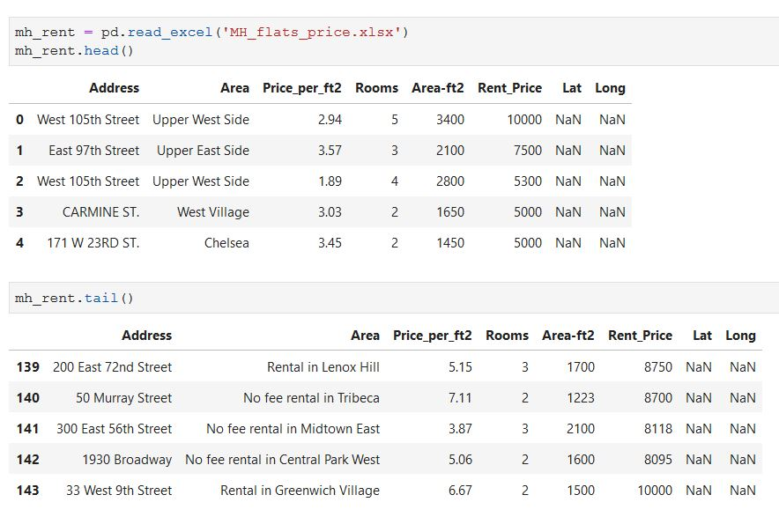
Geodata of Apartments for rent in Manhattan

Slide 11
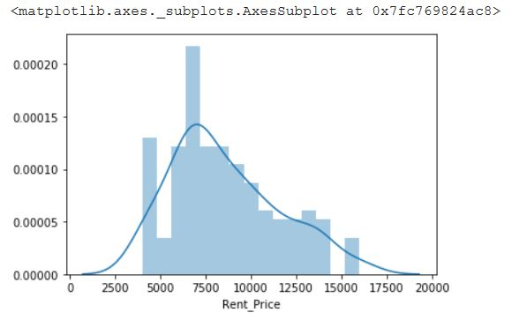
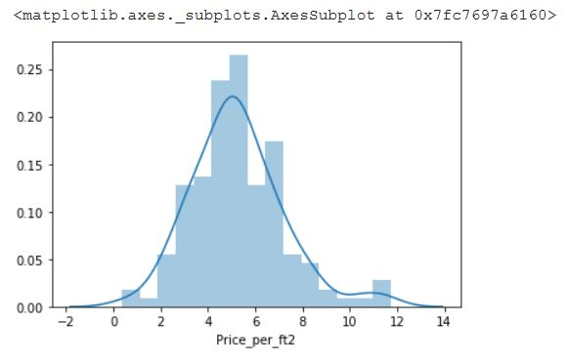
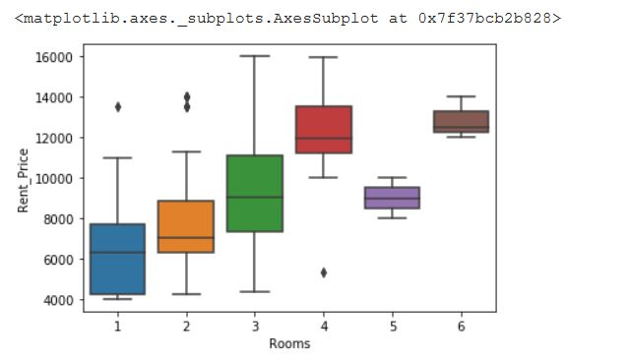
Statistics – Rental price of apartments in Manhattan

Slide 12
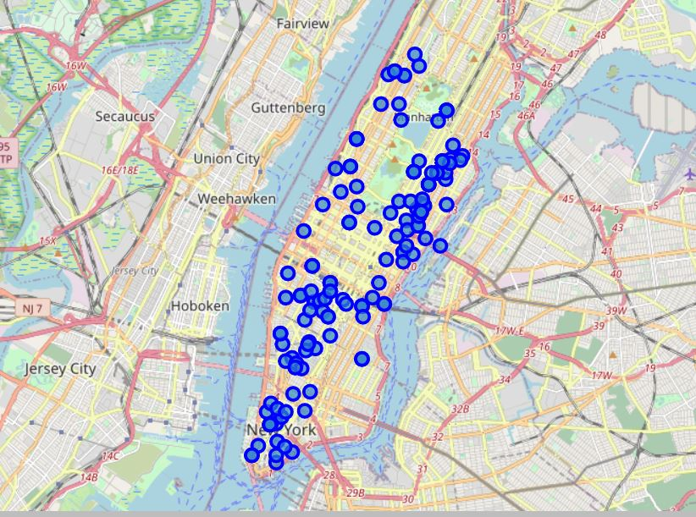
Apartments for rent in Manhattan

Slide 13
Map - Apartments for rent with venue clusters in Manhattan

Slide 14
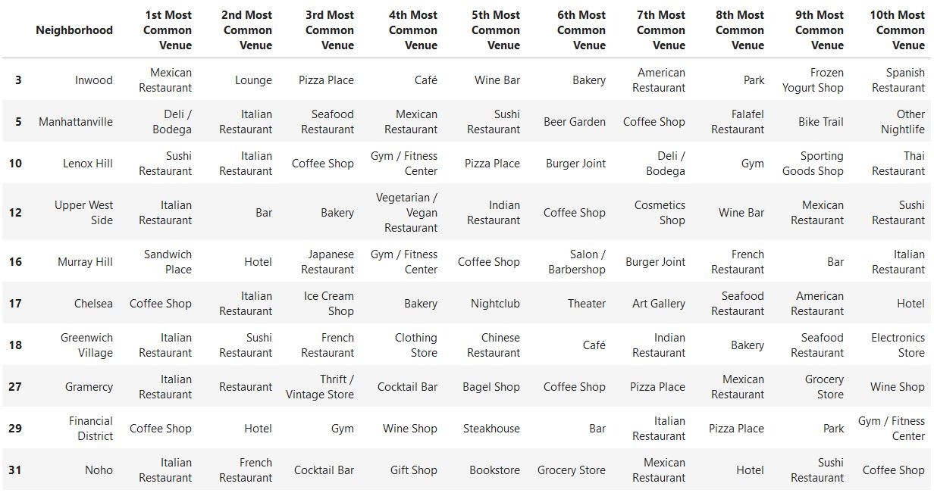
Venues of cluster 3

Slide 15
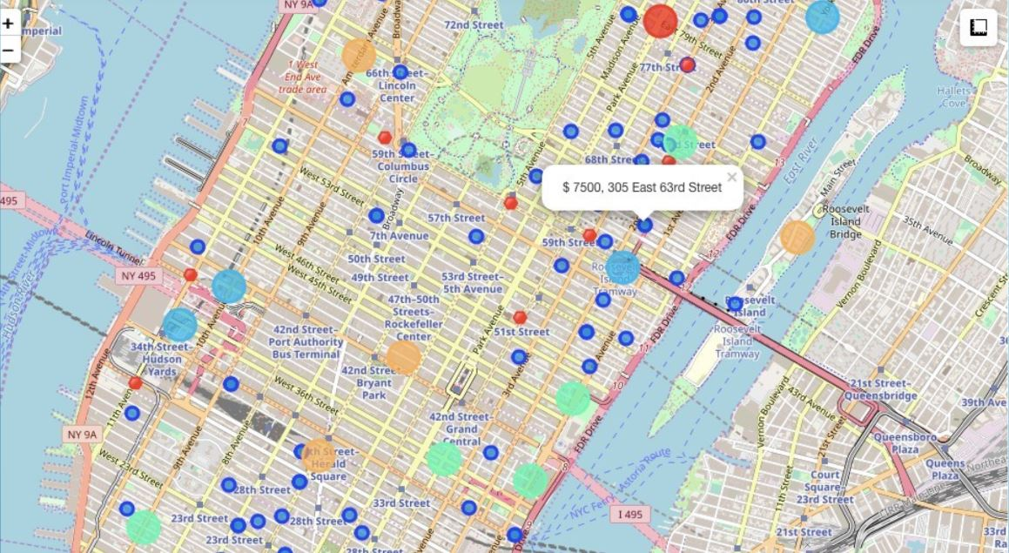
Selected Apartment

Slide 16
Apartment Selection
Using the "one map" above, I was able to explore all possibilities since the popups provide the information needed for a good decision.
Apartment 1 rent cost is US7500 slightly above the US7000 budget. Apt 1 is located 400 meters from subway station at 59th Street and work place (Park Ave and 53rd) is another 600 meters way. I can walk to work place and use subway for other places around. Venues for this apt are as of Cluster 2 and it is located in a fine district in the East side of Manhattan.
Apartment 2 rent cost is US6935, just under the US7000 budget. Apt 2 is located 60 meters from subway station at Fulton Street, but I will have to ride the subway daily to work, possibly 40-60 min ride. Venues for this apt are as of Cluster 3.
Based on current Singapore venues, I feel that Cluster 2 type of venues is a closer resemblance to my current place. That means that APARTMENT 1 is a better choice since the extra monthly rent is worth the conveniences it provides.

Slide 17
5 Discussions
In general, the goal to find the venue for apartment has been achieved.
I feel this Capstone project presented me a great opportunity to practice and apply the Data Science tools and methodologies learned.
I feel I have acquired a good starting point to become a professional Data Scientist and I will continue exploring to creating examples of practical cases.
6 Conclusion
I feel rewarded with the efforts, time and money spent. I believe this course with all the topics covered is well worthy of appreciation.
This project has shown me a practical application to resolve a real situation that has impacting personal and financial impact using Data Science tools.
The mapping with Folium is a very powerful technique to consolidate information and make the analysis and decision thoroughly and with confidence. I would recommend for use in similar situations.

